Slide 1

Improve the quality of evidence synthesis in social sciences with reproducible meta-analyses templates
Adrien Fillon 26.09.2022

Slide 2
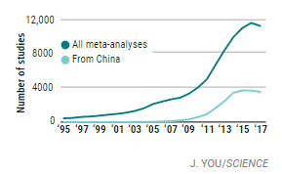
Meta-analysis
Belongs to cumulative science
For some, is the highest level of scientific evidence
Allows recommendations to be made (Ex: Cochrane)
Helps us understand differences between individual studies (heterogeneity)
More and more meta-analyses are published
The method is constantly moving

Slide 3
In Psychology

Slide 4
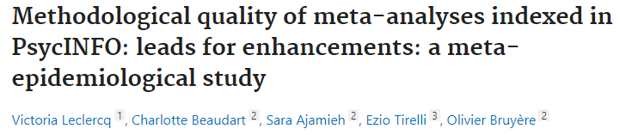
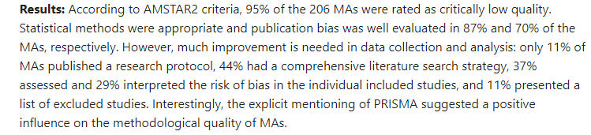

Slide 5
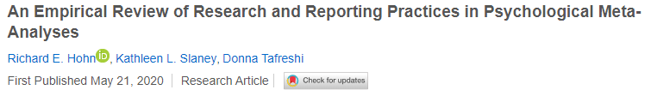
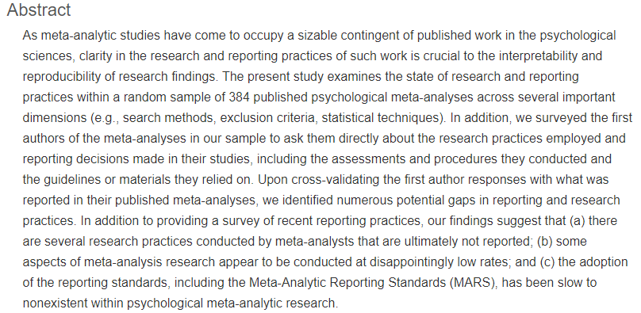

Slide 6
In Economy

Slide 7
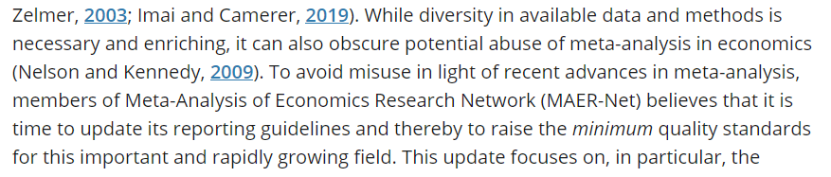
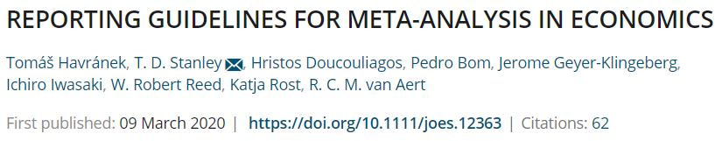
Social and cognitive psychology have more in common than micro and macro economy. It is then difficult to assess the overall quality of meta-analyses in economy.
We still find certain behaviors making the assessment of the quality in a meta-analysis hard.
For example, Xue et al. (2019) used 12778 data point estimates on social capital and health from 470 studies.
Gechert et al. (2019) collected 71 variables to explain heterogeneity.

Slide 8
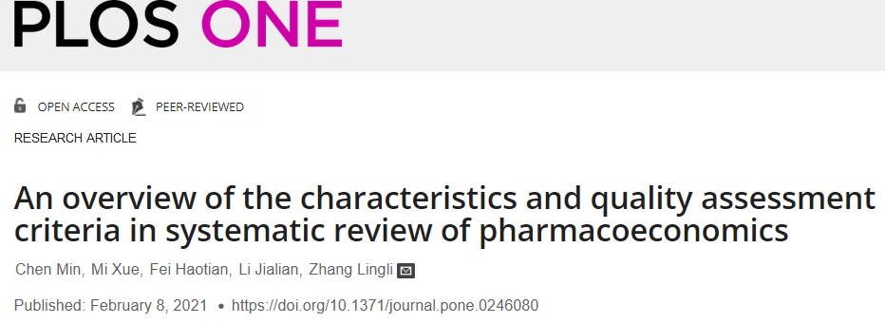


Slide 9
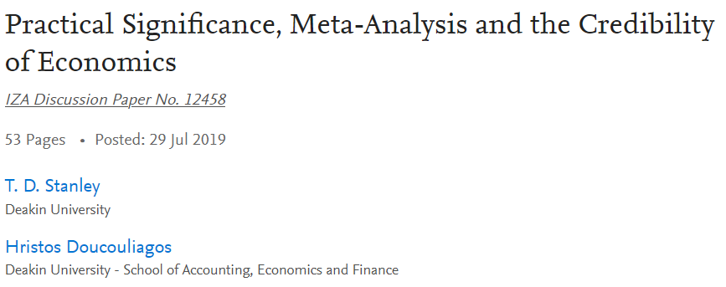
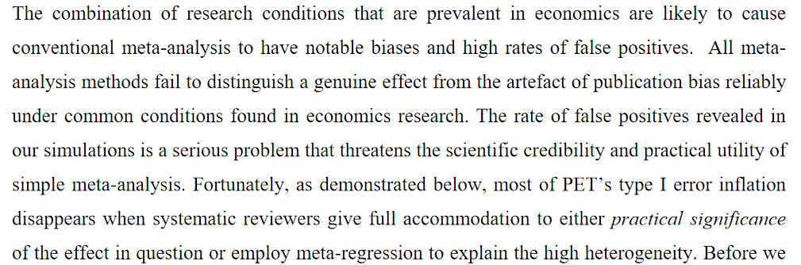
Statistical vs. Practical significance

Slide 10
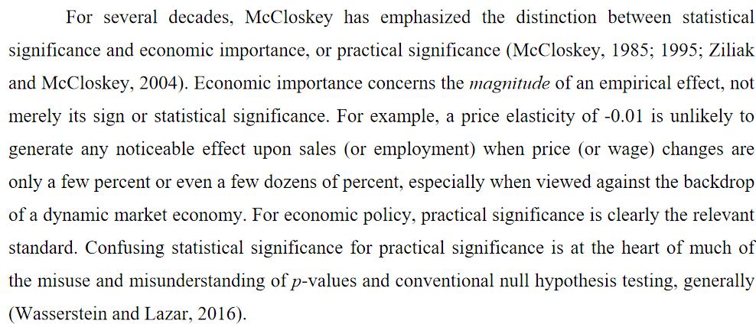

Slide 11
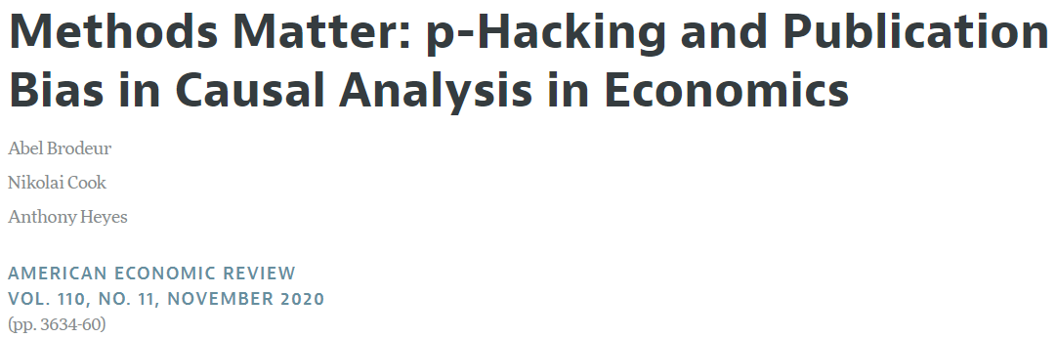
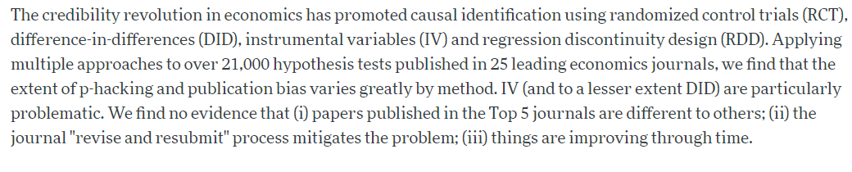
Meta-analyses are in the form of « garbage in, garbage out »: we need to make sure the effect sizes included are reliable and not a result of questionnable research practices.

Slide 12
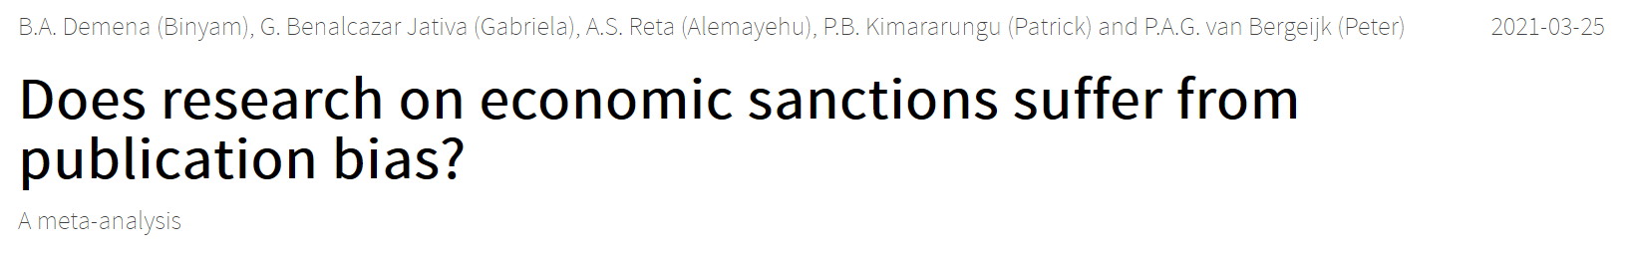
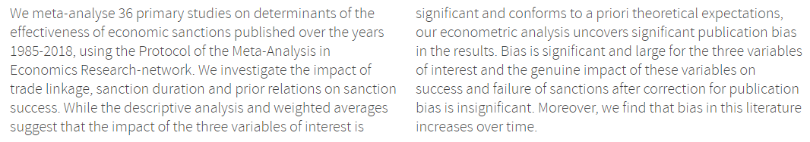

Slide 13
What are meta-analyses of high quality ?
They follow standard report guidelines
They are transparent and reproducible, methodologically and statistically
They systematically examine and try to reduce/take into account publication biases
They are not themselves victim of publication biases

Slide 14
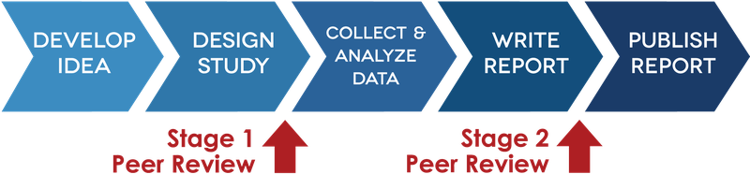
Registered report meta analysis templates
1 manuscript (introduction/method/result/discussion)
1 supplementary with templates for e-mails, checklists, diagrams and additional ressources
1 Excel template to code the data
1 Rmarkdown code template to analyse data and automatically create an outcome PDF file to copy paste to the manuscript.

Slide 15
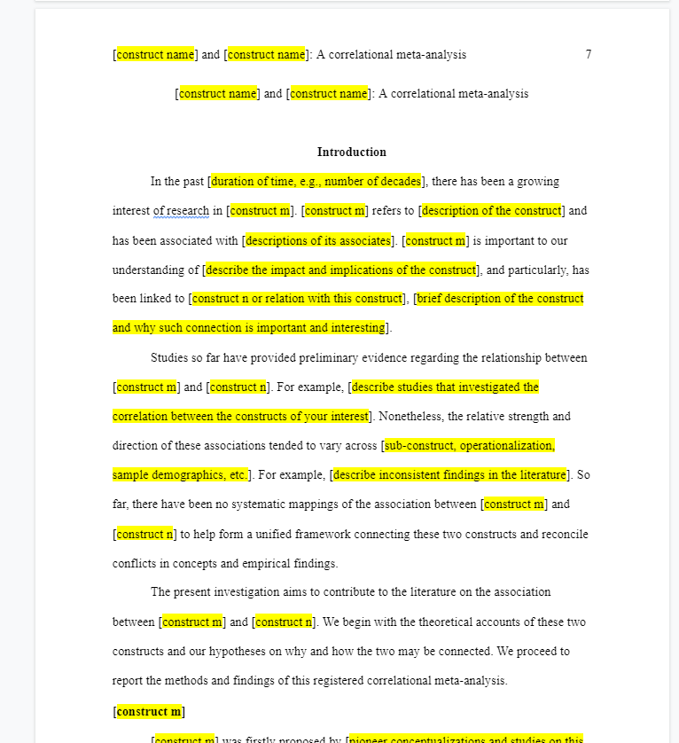
In blank text, already written
Highlighted and in brackets: to adjust to your own meta-analysis.

Slide 16
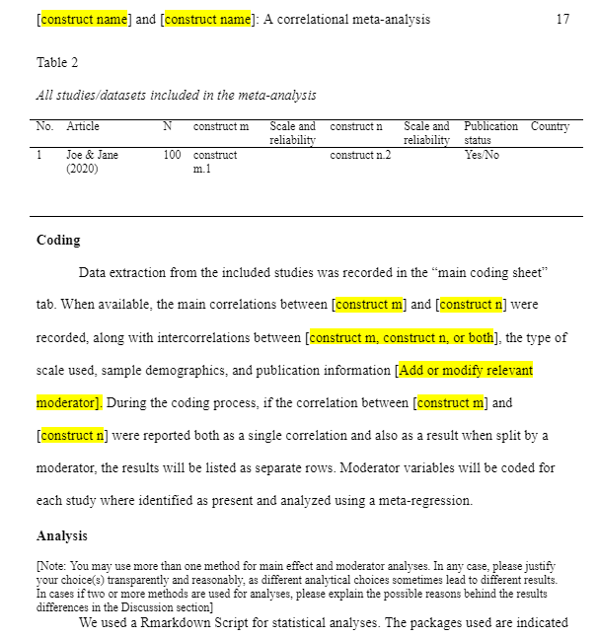
Tables and figures are proposed to be filled
In smaller font, indications on how to use the template for this section

Slide 17
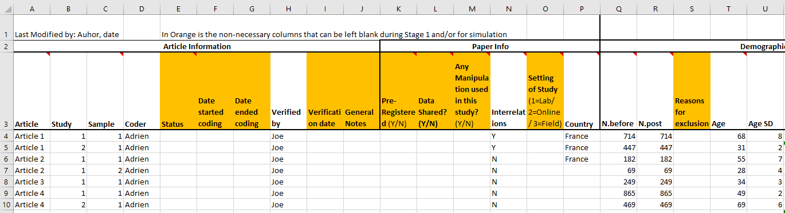
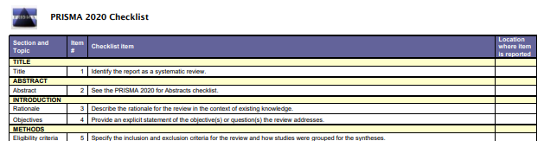
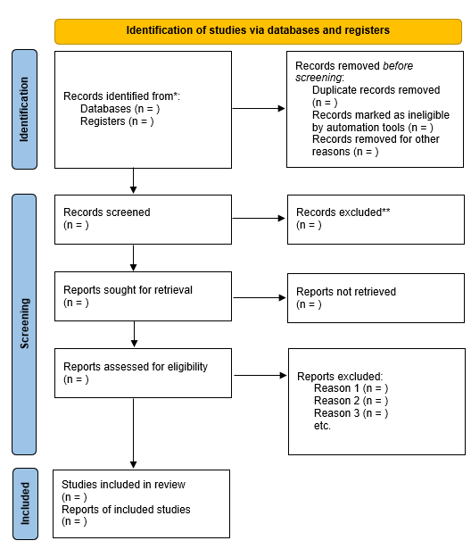

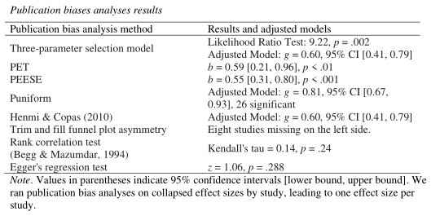
Checklist
Transparent diagram on inclusion/exclusion criteria
Data sharing
Reproducibles analyses
Publication bias tests

Slide 18
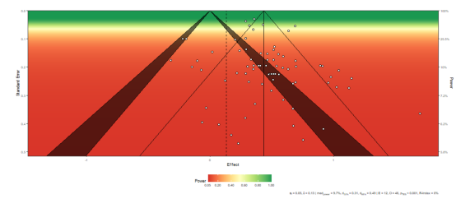
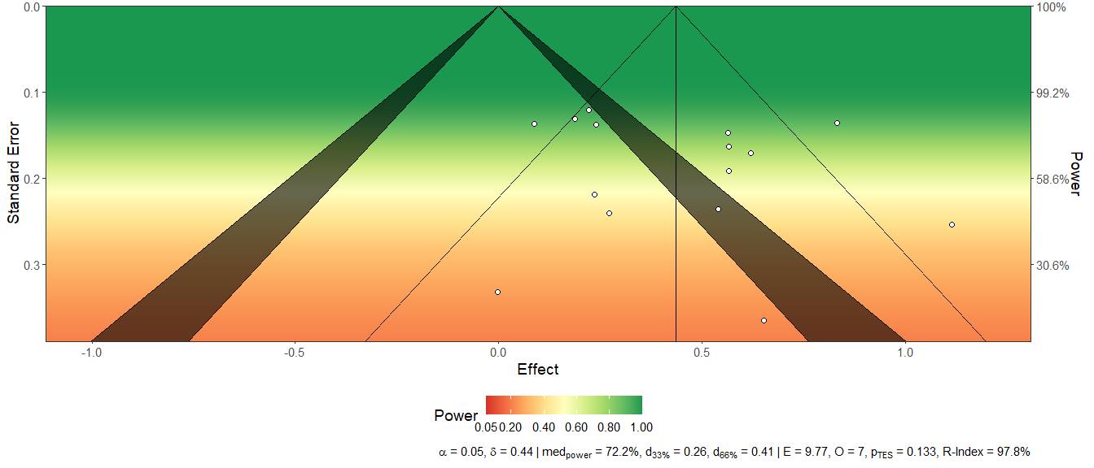
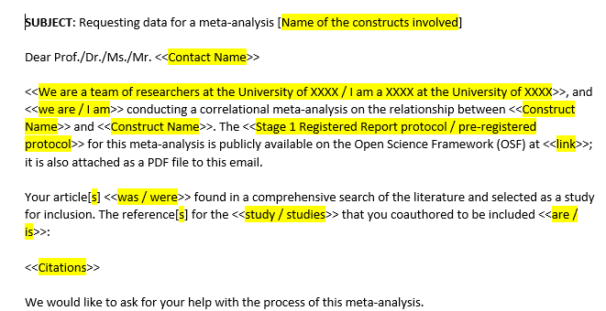
Test of statistical power
E-mail templates
(next to implement: ROB2 analysis)

Slide 19
2 meta-analysis templates
Experimental meta-analysis
Correlational or psychometric meta-analysis
Compares the difference between two groups
The objective is to find the effect of the experiment
Based of Hedge’s g
Measures the link between two constructs
Based on Pearson’s r
Can evaluate inter-relationships between subconstructs
Takes into account the reliability of the scales when measuring the link between constructs (Cronbach’s α or McDonald’s Ω)

Slide 20
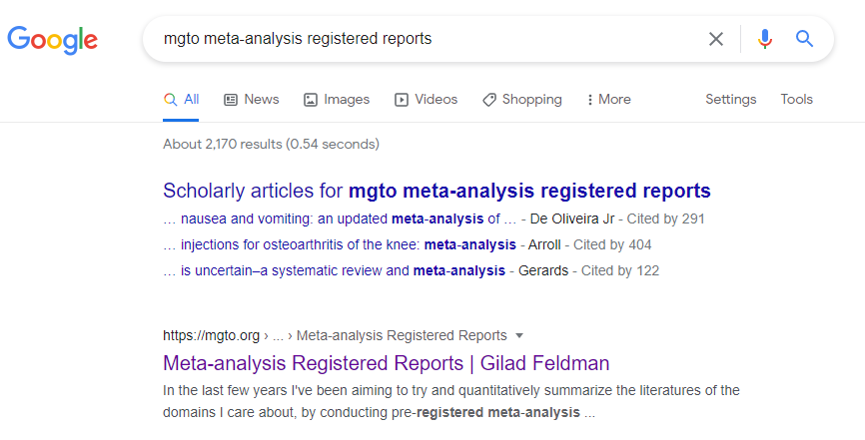
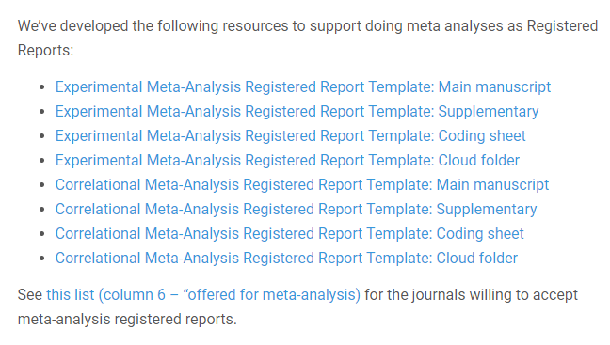
Available through this link:
https://mgto.org/meta-analysis-registered-reports/

Slide 21
Méta-analysis based on these templates
Published
Fillon, A., Kutscher, L., & Feldman, G. (2020). Impact of past behavior normality on regret: Meta-analysis of exceptionality effect. Cognition and Emotion. DOI: 10.1080/02699931.2020.1816910 SMAS
Lim, V., & Feldman, G. (2022). Values and the dark side: Meta-analysis of links between Dark Triad traits and personal values. Journal of Research in Personality. [Registered Report Stage 1 in-principle acceptance]
Nanakdewa, K., et al., Savani, K., & Feldman, G. (2022). Outcomes associated with believing in free will: Meta-analysis. Journal of Research in Personality. [Registered Report Stage 1 in-principle acceptance]
To be published
Bialek, M., Gao, Y., Yao, D., & Feldman, G. Owning leads to valuing: Meta-analysis of the Mere Ownership Effect. DOI: 10.13140/RG.2.2.13568.33287/1 SMASH
Omission-commission asymmetries in moral judgements and decisions: Meta-analysis of Omission-Bias.
Action-inaction asymmetries in judgment and emotions: Meta-Analysis Registered Report of the Action Effect. [Google Doc manuscript, work in progress]
Fillon, A. A., Souchet, L., Pascual, A., & Girandola, F. (2020). The effectiveness of the “But-you-are-free” technique: Meta-analysis and re-examination of the technique. Center for Open Science. https://doi.org/10.31234/osf.io/3ds26
Jaubert, S., Fillon, A. A., Souchet, L., & Girandola, F. (2020). Vicarious Dissonance : Meta-analysis registered report. Center for Open Science. https://doi.org/10.31234/osf.io/hc2n3

Slide 22
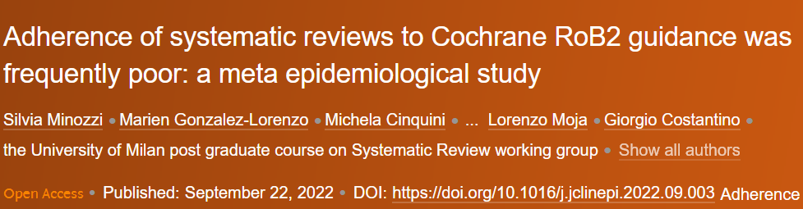
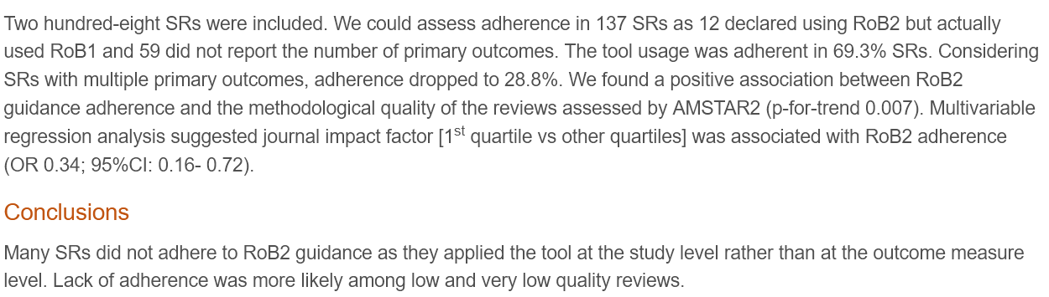
Will templates improve the quality of meta-analyses ?
I hope yes, atleast a bit so that I didn’t put so much effort for nothing.
But it won’t be enough: we need better training and dissemination of good practices

Slide 23

Thank you!
Fillon, A., Xiao, Q., Elsherif, M., Yeung, S.K., Nanakdewa, K., Protzko, J., Brick, C., Moreau, D., Feldman, G. (2021). Correlational Meta-Analysis Registered Report Template [In preparation]
Yeung, S. K., Feldman, G., Fillon, A., Protzko, J., Elsherif, M. M., Xiao, Q., & Pickering, J. (2021). Experimental Studies Meta-Analysis Registered Report Templates [In Preparation]
@adfillon adrienfillon@hotmail.fr

